Slide 1

Visual
Basic for
Applications
(Excel)
Speed Up and Automate
Daily Data Processing

Slide 2
Using Excel/VBA to Speed-up Daily Data Processing
An Introduction to VBA

Slide 3
An Introduction to VBA
- What is VBA
An abbreviation for Visual Basic for Applications
Official name is "Visual Basic, Applications Edition."
VBA is Microsoft's common application programming (macro) language for Word, Excel, Access, etc.
Also being implemented in other Microsoft applications such as Visio and is at least partially implemented in some other applications such as AutoCAD...
VBA and VB have a lot in common, but they are different. VB is a programming language that lets you create standalone executable programs.

Slide 4
An Introduction to VBA
- What Can You Do With VBA
Write Macros to Automate Labor-Intensive and Repetitive Tasks
Create User-Defined Functions to Achieve Complicated Functionality
Create Standard Windows Menu/Tool Bars for Interface
Interact with Other Windows Programs (like Matlab)
I/O with External Files
Database Operation ….

Slide 5
An Introduction to VBA
- VBA- Object Based Programming Language
C++, Java, etc. are OOP (Object Oriented Programming) Language
VBA is an Object Based Programming Language
What is Object?

Slide 6
An Introduction to VBA
- VBA Object Based Programming Language
Concepts – Containers or Collections
  A Group of Similar Objects Share Common Properties, Methods and Events
  Such as Workbooks, Worksheets, etc.
  Worksheets is a collection of all the Worksheet objects in the specified or active workbook.
  Worksheets(1) refers to the 1st worksheet of current active workbook.
  Worksheets (“employees”) refers to the worksheet named “employees”.

Slide 7
An Introduction to VBA
- VBA Object Based Programming Language
Concepts – Objects
  Such as Worksheet, Workbook, Range, Cell, Chart, Name, etc.
  Worksheets(1) is an Object Referring to the First Sheet
  Range("A1:B15") is an Object Referring to a Range
  Cells(1,1) or Range(“A1”) is an Object Referring to Range “A1”

Slide 8
An Introduction to VBA
- VBA Object Based Programming Language
Concepts – Properties
  Properties are the Physical Characteristics of Objects and Can be Measured or Quantified.
  Properties for Collections
  - Worksheets.Count (Read Only)
  - Worksheets.Visible = True (Read and Write)
  Properties for Object
  - Range("A1:B15").Rows.Count (Read Only)
  - Range("A1:B15").Font.Bold = True (Read and Write)

Slide 9
An Introduction to VBA
- VBA Object Based Programming Language
Concepts – Methods
  Methods are the Actions that Can be Performed by Objects or on Objects
  Methods for Collections
  - Worksheets.Add
  - Worksheets.Delete
  Methods for Objects
  - Range("A1:B15").ClearContents
  - ActiveCell.Copy

Slide 10
An Introduction to VBA
- VBA Object Based Programming Language
Concepts – Events
  Objects Can Respond to Events, Such as Mouse Click, Double Click on a Cell, Active a Worksheet, Open/Close/Save a Workbook, etc.
  Worksheet Events –
    Such as Activate, Deactivate, Change, Selection Change, Before Double Click, etc.
  Workbook Events-
    Such as Activate, Deactivate, Open, Before Close, Before Saving, Before Print, New Sheet.

Slide 11
An Introduction to VBA
- VBA Object Based Programming Language
Concepts – Referring To
  Use brackets () to refer to member object
    Worksheets(“employees”)
  Use dot . to refer to child object or object’s properties and methods
    Worksheets(“mooring”).Range(“A1:B3”).Font.Bold

Slide 12
An Introduction to VBA
- VBA Object Based Programming Language
Concept
Summary

Slide 13
An Introduction to VBA
- VBA Object Based Programming Language
Understand Object Concepts
Workbooks("book1.xls").Worksheets("sheet1").Range("A1").Font.Bold = True
ActiveWorkbook.ActiveSheet.Cells(1, 1).ClearContents
Private Sub Workbook_Open()
MsgBox "Thank you for choosing VBA"
End Sub

Slide 14
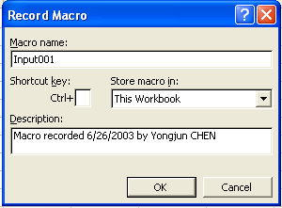
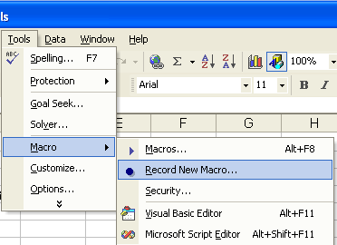
An Introduction to VBA
- First Step to VBA : Macros
Record Macro
  Similar to audio/video recorder
  Record all the steps you conduct and write them in VBA code
If macros are disabled when you start Excel, change the security level to medium

Slide 15
An Introduction to VBA
- First Step to VBA : Macros
Assign Macro to An Event
  Normally User Run Macros from VBA Edit Window – Unnecessary
  User Can Assign Macro to An Event, Normally a Button Click Event
  Easy to Execute and Easy to Remember
  Give a Good Name for The Button and Click the Button to Run the Macro

Slide 16
An Introduction to VBA
- First Step to VBA : Macros
Assign Macro to An Event

Slide 17
An Introduction to VBA
- Second Step to VBA : Edit Macro
VBA Editor Window
  Press Alt+F11 to Activate VBA Window
  Or Go to Menu Tools>Macros>Visual Basic Editor
  Project Explore Window
  Properties Window
  Code Window
  Tools>Options>Docking Window

Slide 18
An Introduction to VBA
- Second Step to VBA : Edit Macro
VBA Editor Window
  Use Tools/Options to Enable Auto Syntax Check, Auto List Members, etc.
  Use Tools/Properties to Protect Your Code with Password – You Must Remember the Password
  Insert Module, Procedure, Form

Slide 19
An Introduction to VBA
- Second Step to VBA : Edit Macro
Sample
  Record Macro
  Understand Macro
  Modify Macro
  Assign Macro to Button Click Event

Slide 20
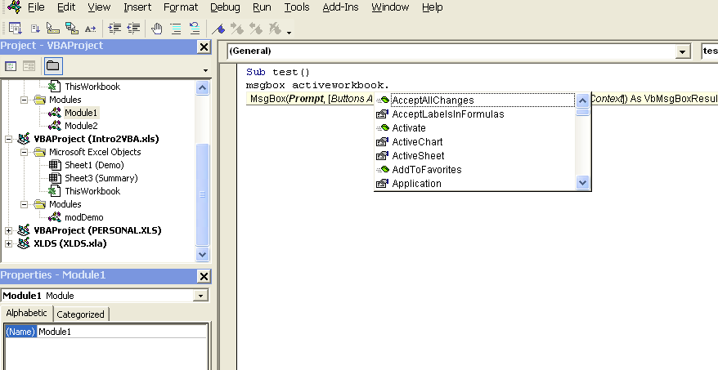
An Introduction to VBA
- Second Step to VBA : Edit Macro
Understand VBA Editor Window
Project window
Shows files, sheets and modules
Auto list member
Auto list data / parameter
Property window
Show properties of active object and let user to modify the properties
Code window
VBA codes are here.

Slide 21

Demonstration and Hands-on Time!

